Slide 1
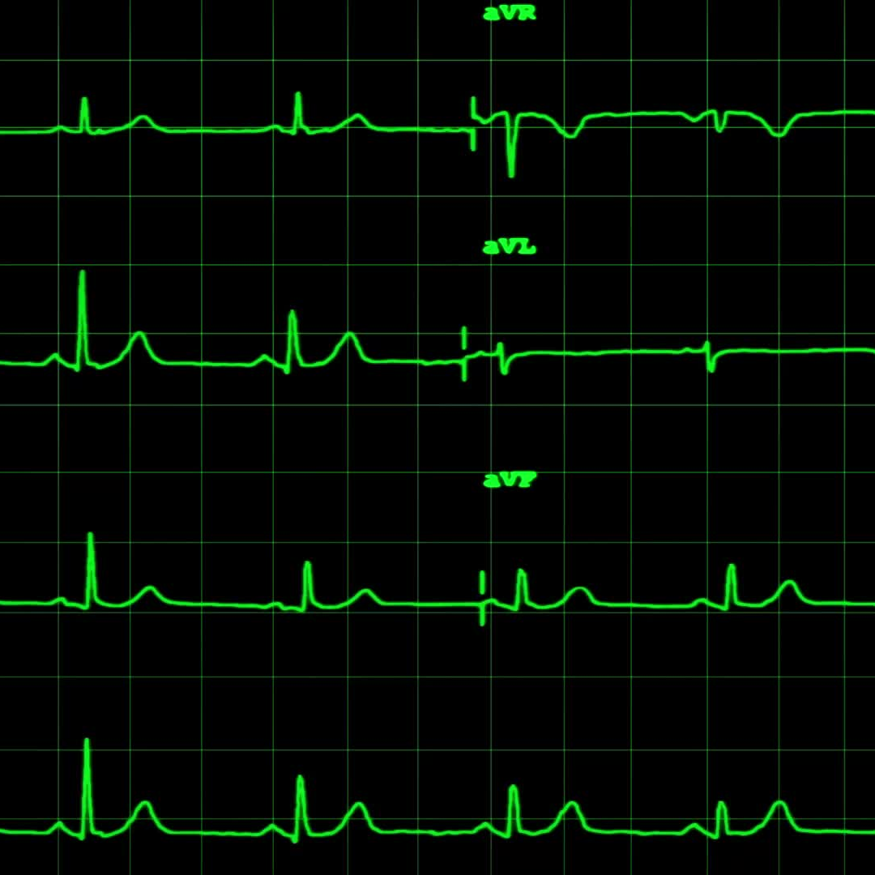
Heart Attack Risk Predicton
Using Logistic Regresstion
Course Name: Machine learning and Smart Systems A+B
Name :Beatrice Raphael Msokwa (Matr :38548252)

Slide 2
Project Overview &Objective
The Problem: CardioVascular disease is a leading global health challenge .
Objective : Implement a supervised Logistic Regression Classifier in python to predict patient heart attack Risk

Slide 3
Dataset Overview
Source : Kaggle Heart Attack Prediction Dataset (8,763 records, 26 features)
Features Included
Demographics: Age,Sex
Lifestyle : Smoking, Exercise
Medical Indicator: Cholesterol , blood pressure ,BMI
Target Variables: Binary Classification (0= Risk ,1= No Risk)

Slide 4
Data Preprocessing
Pipeline
Step1:Cleaning
Removed Unique Identifiers (Patient ID, Patient Name )
Step 2: Categorical Encoding
Turning word into anaumbers (since Robot don’t only understands numbers) via one hot encoding (pd.get dummies)
Step 3:Scaling
Standardised numerical features with standardscalar to ensure stable gradient descent convergence(some numbers are huge (eg cholesterol levels of 250) while others are tiny (eg age 50) If you don't scale them, the big numbers bully the small ones. This step puts all the numbers on a fair, equal playground so the robot doesn't get confused.)
Step 4: Stratified Split
Divided data into 80% training and 20 % testing partitions

Slide 5
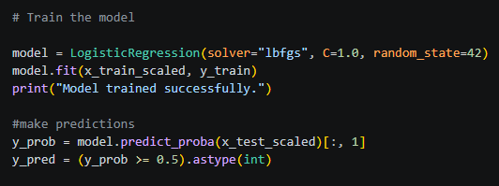
Logistic Regression Architecture
Mathematical formulation and scikit-learn parameter configuration
Sigmoid Hypothesis Function
P(y=1|x) = 1 / (1 + e^(-z))
Linear Decision Boundary
z = β₀ + β₁x₁ + β₂x₂ + ... + βₙxₙ

Slide 6
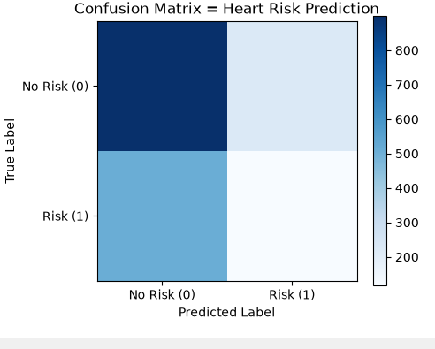
Model Evaluation & Confusion Matrix
899
True Negative (safe)
226
False Positive (Alarm)
Overalll Accuracy is 58%
511
False Negative (Missed)
117
True Positive (Caught)
The Medical limitation
High false negatives (511) highlight that raw accuracy is insufficient for imbalanced medical data.

Slide 7
Conclusion
Key Takeaways
Pipeline Success: Successfully built and executed a complete 8-step machine learning pipeline in Python.
Accuracy is Deceptive: Raw accuracy (~58%) looks okay on paper, but high false negatives show why medical datasets require checking the Confusion Matrix and Recall.
Alternative Models
Random Forest: Combines multiple decision trees to find complex patterns that a simple straight line (Logistic Regression) might miss.
Support Vector Machines (SVM): Excellent at drawing precise boundary lines to separate healthy patients from at-risk patients.

